Slide 1
Specification by Example
Karel Smutný, 2024

Slide 2
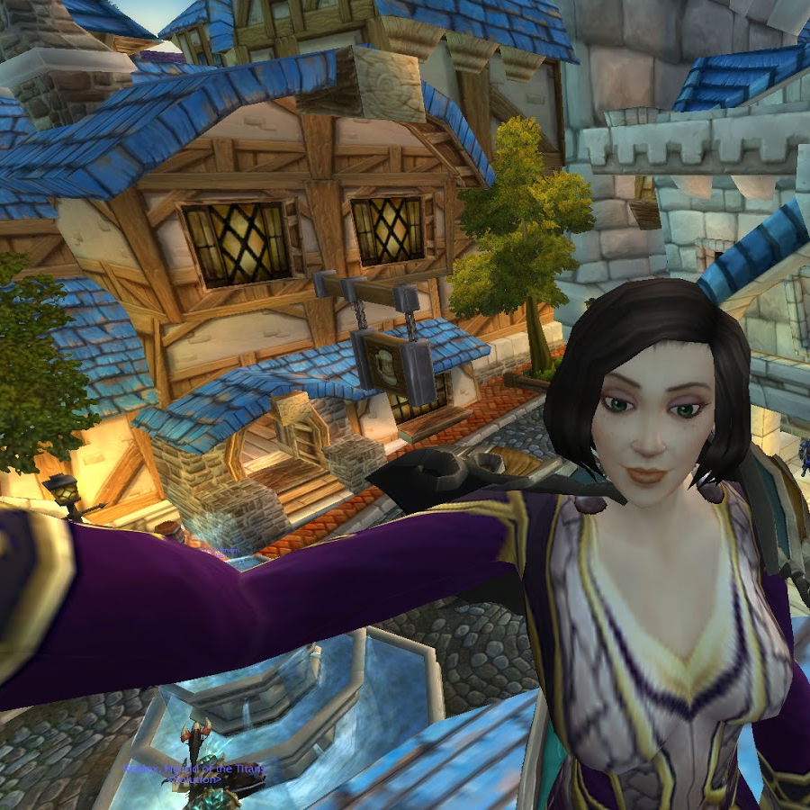
Welcome to Gilded Rose
Our goods are constantly degrading in Quality as they approach their sell by date.
All items have a SellIn value which denotes the number of days we have to sell the items.
All items have a Quality value which denotes how valuable the item is.
At the end of each day our system lowers both values for every item.

Slide 3
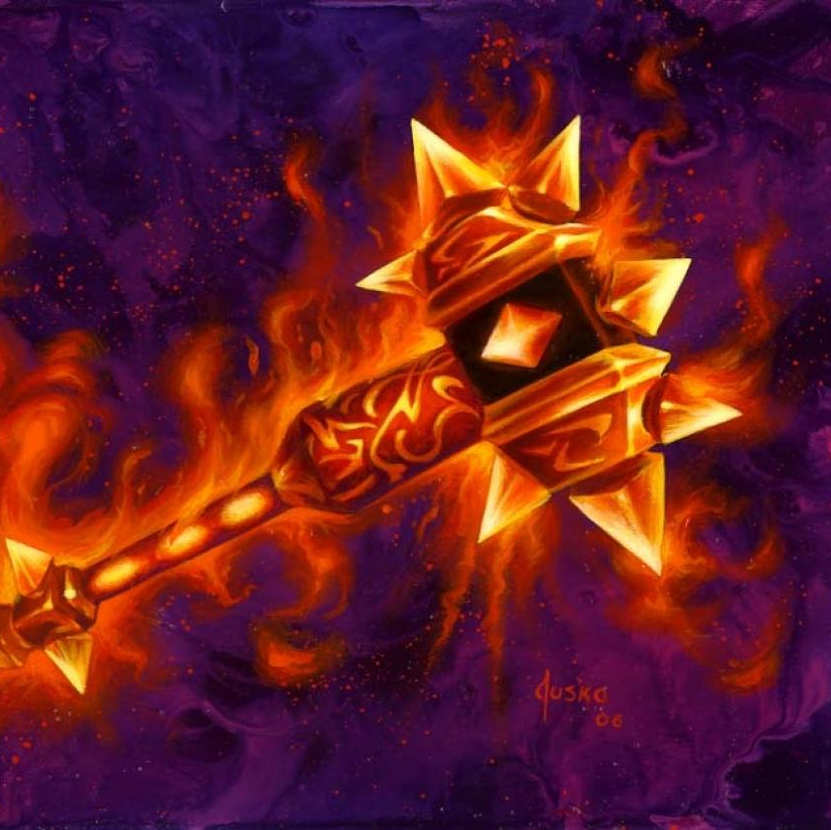
Once the sell by date has passed, Quality degrades twice as fast.
The Quality of an item is never negative.
"Aged Brie" actually increases in Quality the older it gets.
The Quality of an item is never more than 50.
"Sulfuras", being a legendary item, never has to be sold or decreases in Quality.

Slide 4
Quiz
Quality of "+5 Dexterity Vest", SellIn = 3, changes by ___
Quality of "Elixir of the Mongoose", SellIn = 0, changes by ___
Quality of “Sulfuras, Hand of Ragnarok", changes by ___
Quality of “Aged Brie", SellIn = -3, changes by ___

Slide 5
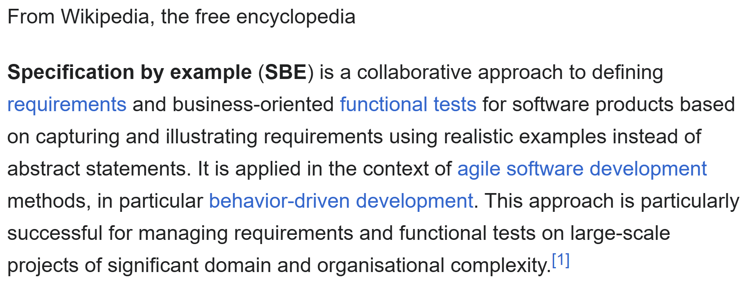
Specification by Example

Slide 6
Specification by Example a.k.a.
Acceptance Test-Driven Development
Agile Acceptance Testing
Behavior-Driven Development
Test-Driven Requirements
Example-Driven Development
Executable Specifications

Slide 7
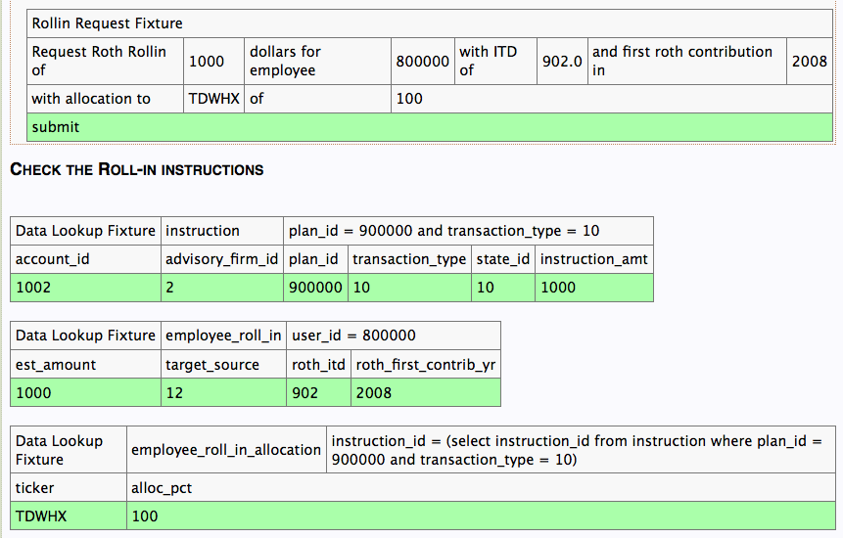

Slide 8
Which is better?
Scenario: As an existing user, I want to log in successfully
Given the user is on the Home page
When the user clicks on the login link on Home Page
And the user can see the login screen
And the user enters his username and password
And the user is able to click on the login button
Then the user is logged in successfully
And the successful login message is displayed
Scenario: As an existing user, I want to log in successfully.
Given the user is on the Home page
When the user navigates to the Login page
And the user enters the username and password
Then the successful login message is displayed

Slide 9
How to start?
Just start!

Slide 10
How to start
Pick a fairly complex functionality
Get the customer and the whole team to the same room
Write some Specifications
Run them manually at the end of every Sprint
Turn them into automated tests (will be painful)
Rinse and repeat

Slide 12
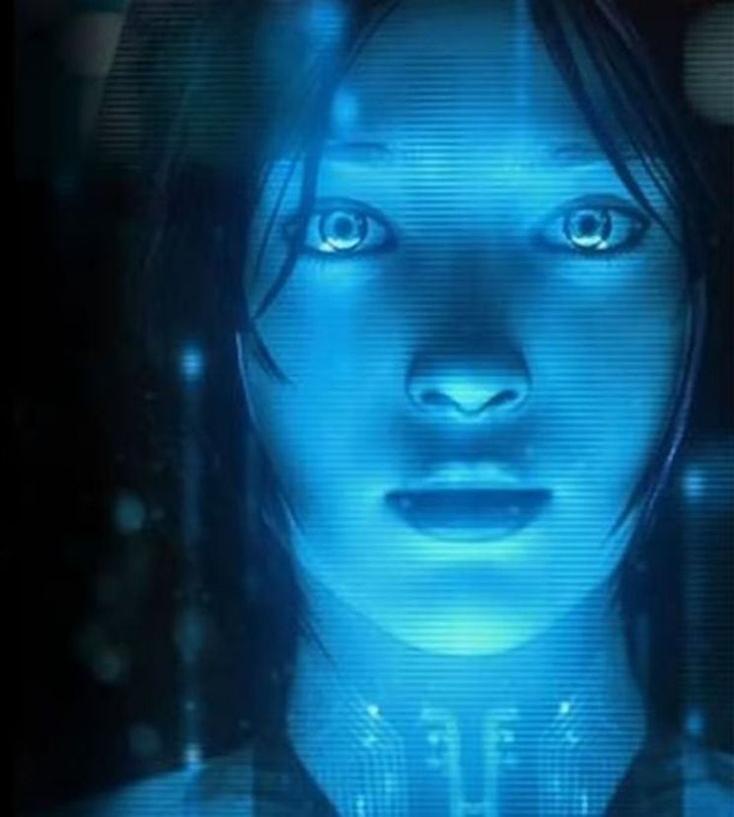
What about AI?

